Slide 1
Embedded IoT Application on Wemos D1 Mini
By Khaled Soliman
900162031

Slide 2
Outline
Project prompt
Architecture & Components
Connections
Dev Diary
Github Repo
Limitations
References

Slide 3
Project Prompt

Slide 4
Project Prompt
Create a small IoT application that can enable the user to perform I/O operations with the STM32 module through a web interface.
Operations:
Retrieving the date/time from RTC module connected to the STM32 module
Control the STM32 module LEDs status
Added Operations:
Pinging the STM32 module
Control the WiFi module LEDs status
Retrieving the temperature from RTC module
Setting the time on the RTC module
Setting an alarm on the RTC module

Slide 5
Architecture & Components

Slide 6
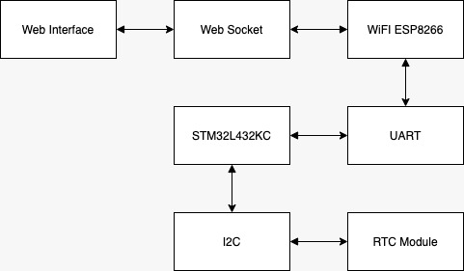
Architecture

Slide 7
Hardware Components Used
Nucleo STM32L432KC
Wemos D1 Mini ESP8266MOD
RTC DS3231
MicroUSB Cable
5V Buzzer

Slide 8
Software Used
Arduino v1.8.12
ES8266 Library
SPIFFS Plugin
STM32CubeMX
Keil uVision 5

Slide 9
Connections

Slide 10
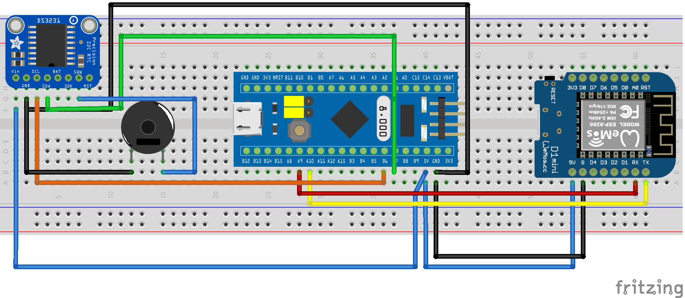
Fritzing Connections

Slide 11
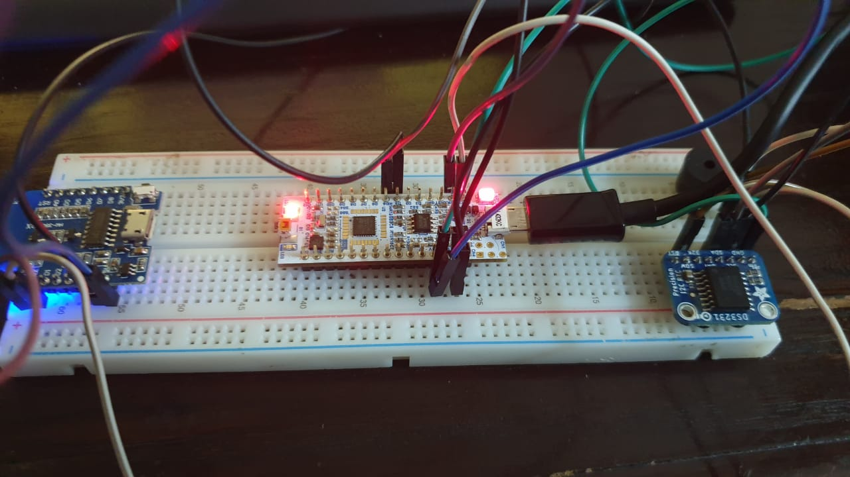
Real Photo of Connections

Slide 12
Dev Diary

Slide 13
Milestone 1:
Web Server
Chose Arduino to program the WiFi module instead of Lua since I haven’t used Arduino before
Implemented an HTML page in program memory and served it using the library <ESP8266WebServer.h>
Communication through HTTP requests

Slide 14
Milestone 2:
Designing Interface and moving to Filesystem approach
Used bootstrap 4 css to design the HTML Page
The CSS file was too large to serve through program memory efficiently
Chose to serve the index.html page through the onboard memory (4 MB)
Used SPIF File System although could have used LittleFS as well

Slide 15
Milestone 3:
Programming the STM32 microcontroller
Programmed the uC using Keil IDE
Increased clock speed of the uC to efficiently respond to UART commands from WiFi module
Deliberated using FreeRTOS

Slide 16
Milestone 4:
Better Web Server Communication
HTTP Requests require refreshing the page
Migrated to websocket communication
Designed a console output box for debugging and viewing output from WiFi module

Slide 17
Github Repository

Slide 18
Github
Project published on github under MIT License
https://github.com/KhaledSoliman/EmbeddedIoTWiFiESP8266

Slide 19
Limitations

Slide 20
Limitations
SPIFFS is deprecated and should migrate to LittleFS for better directory structure
Web Server serves clients on a public socket (Improve websocket communications)
If any of the HTML or CSS3 files get too large web server faces issues in serving them (Stream data by chunks)
Implement FreeRTOS or similar functionalities in the microcontroller for better response time/extensibility
Command structure should be simplified for faster communication.

Slide 21
References

Slide 22
References
https://docs.wemos.cc/en/latest/tutorials/d1/get_started_with_arduino_d1.html
https://tttapa.github.io/ESP8266/

